Slide 1
Energy storage
Mark Barrett
UCL Energy Institute, London
The Mediterranean Green Energy Forum 2013, Fez, Morocco, June 2013
Chemical
Heat
Battery
Capacitor
Notes:
Simulates the system on any time steps. Demand for heat, light, appliances, power. It looks at the supply of the energy tech on the same time step and traces the flow of energies from primary to demand through the network of energy transformation and store. It calculates carbon emiss. And cost. It can be run for any period between 10 and 50 years and produce scenarios.

Slide 2
Why storage?
Storage costs money and consumes energy.
The only point of storage is if it reduces the total capital and operating costs of meeting energy and environment objectives.
It can:
store renewable or other low marginal cost supply for when this supply is in deficit
reduce the use of higher cost marginal supplies
reduce peak flows and capital investment in generation, transmission etc.
reduce the variability of demand which is costly, especially to electricity generation
improve system reliabililty – e.g. if a power station fails
Transmission interconnection can produce most of the same benefits – how much storage, how much transmission?

Slide 3
Storage types

Slide 4
Storage data
Density – kWh/kg, kWh/m3
Lifetime – cycles
Charge/discharge rates
Indicative costs
Large scale economies
Heat storage lower cost than elec
What are costs of input and output capacities?

Slide 5
As the storage temperature increases, the heat pump performance deteriorates
Storage interactions with the system
Example: heat pump and storage temperature
(winter’s day modelled at 5 min intervals)

Slide 6
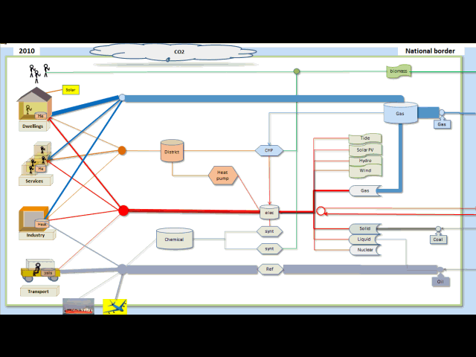
The national energy system
Notes:
DynEMo models a range of dwellings and occupancy types. Two commonly proposed archetypes are shown in here.

Slide 7
National – electrically connected storage
What matters most technically?
kW in
kWh stored
kW out
Efficiency = Eout / Ein

Slide 8
SYSTEM CONTROL ALGORITHMS
Algorithms need to control whole system, including:
Building heating and cooling
Stores
Dispatchable generation
Multi-fuel switching – e.g. between heat pumps and CHP
International trade
Algorithms should include forecast demand and supply
Complex non-linear system so need biological, heuristic algorithms

Slide 9
STORAGE CONTROL ALGORITHMS
Example 1: Sequential surplus renewable electricity allocation to stores
The surplus to store control algorithm allocates any uncontrollable electricity surplus to flows with storage – heating, EVs, district heating, synthetic fuel production
The surplus is sequentially allocated according to proximity to service, energy store size and the availability of multi-fuelling:
  domestic (heat stores)
  electric vehicle (batteries)
  services (heat stores)
  industry (heat stores)
  district heating (heat stores)
  synthetic fuels (chemical stores)
  electricity system storage (e.g. pumped storage)
If all demands are met and stores or input capacities are full, any remaining surplus is exported or spilled

Slide 10
Matching demand to supply – DynEMo 1 day for months 1,4,7 ; modelled at 5 min intervals
Storage levels
Electricity generation and trade
Useful energy
Storage modified demands
Uncontrollable renewables

Slide 11
Optimising storage configuration for whole system
What types and sizes of stores connected where in the energy system?
How do we optimise?
1. Accurately simulate whole energy system dynamics over short time steps.
Quite difficult if transmission included as spatial dimension then needed
2. Optimise dynamic system.
Very difficult– system is non-linear over perhaps 500-5000 time steps.
Transmission interconnection can produce most of the same benefits – how much storage, how much transmission?
Should optimise whole system configuration and control at the same time

Slide 12
Thank you for listening. Questions?
Email: Mark.Barrett@ucl.ac.uk
Site : www.SocietyEnergyEnvironment.net

