Slide 1
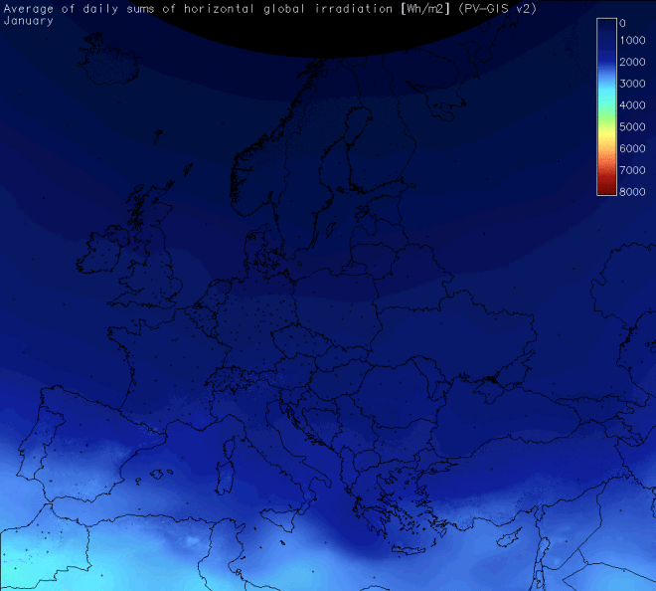
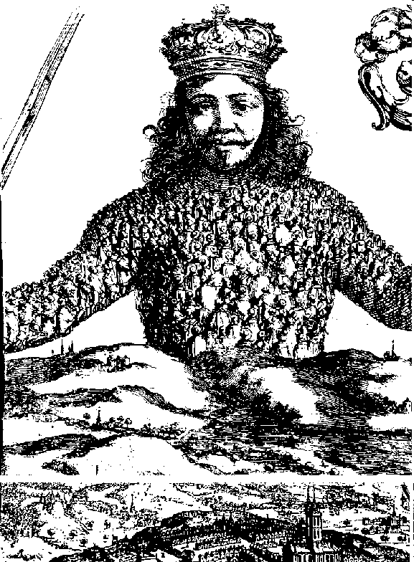
Feeding the Leviathan – people energy and time 0 AD to 2500 AD Mark Barrett
“For by Art is created that great LEVIATHAN […] which is but an Artificiall Man […] in which, the Soveraignty is an Artificiall Soul, as giving life and motion to the whole body” Thomas Hobbes 1651

Slide 2
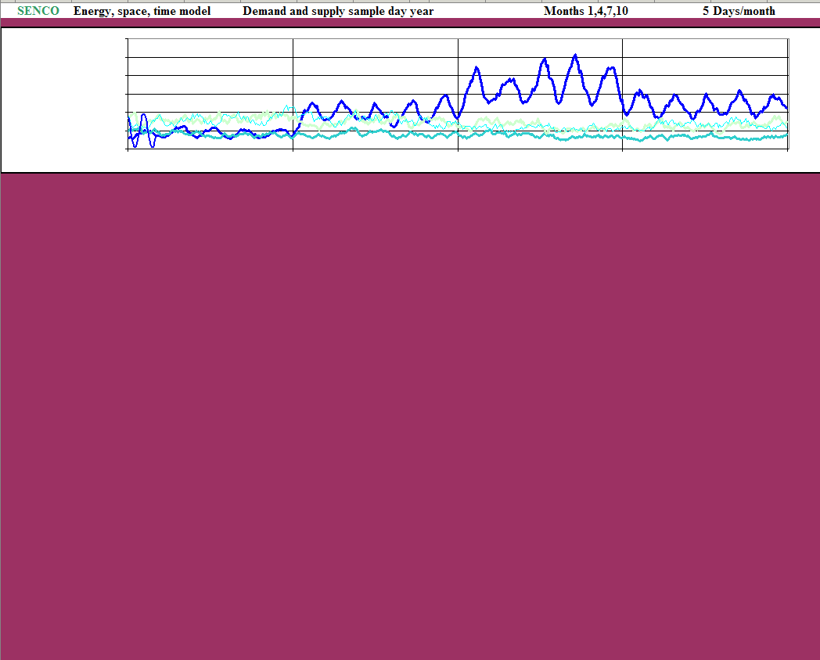
  Leviathan’s environment : from 3.5 billion years ago
  Environment and energy flows vary across minutes, hours, days and years
  Winter Spring Summer Autumn
Energy in the earth’s environment:
  sun => wind => waves
  tides
  radioactivity
The rise
of the replicators
microbes
plants
animals
  (fossil fuels and bio energy are dead replicators)
Notes:
High grade energy to replicate information. Multicellular plants and animals 600 My ago. Warm blooded ~50 My increase energy demand. Variations in energy input met with demand management (e.g. hibernation) and short and long term storage.

Slide 3
From renewable to finite: the last 5 billion years
Leviathan’s ancestors arrive
- 4.5 billion years : Replicating molecules with some errors – evolution
  Integration of chemical reproduction on larger scales
  Carbon the great building block and energy vector
  DNA – the carbon based ink in which life is written
  Absorb energy from the environment to drive information reproduction
The life cycle
Information creates a system that absorbs energy from environment to reproduce information with occasional errors that creates a new system
Problem: most energy supplies not constant in time and space (except geothermal).
Living systems have to
  reduce energy use when supplies are low; hibernate
  store the energy from time of surplus to deficit; lay down seeds, tubers, fat
  acquire energy; move to, collect and transport food.

Slide 4
From renewable to finite: the last 4 billion years
Leviathan’s ancestors arrive

Slide 5
Leviathan appears
Leviathan : the social organism
  Integration of larger numbers of people – multi multi cellular
  Specialisation
  Cooperative energy collection, transformation, storage. Information storage
Extend body’s abilities with exosomatic technologies
  Caves, shelter
  Clothing
  Tools, weapons
  Energy (food) storage – living and dead

Slide 6
0 to 2500 AD
Smart control
renewables=========================> dead replicators => renewables ====>
Notes:
Humans ~ 2 My.
Development of exosomatic systems: agriculture, food storage, shelter.

Slide 7
Energy services – what is it all for?

Slide 8
Homo multicellulus – a life in boxes
People congregate in shelters and transport boxes where most of their energy services are delivered

Slide 9
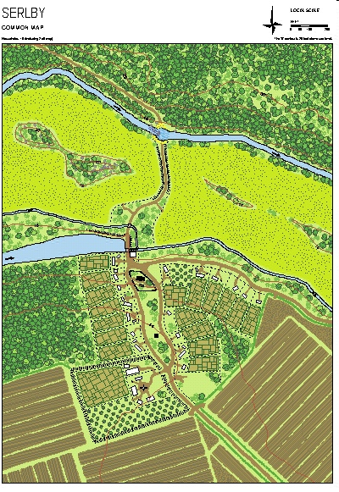
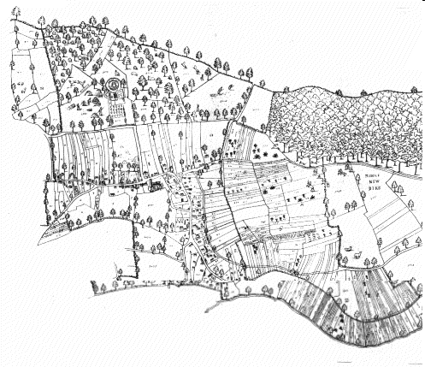
Leviathan – community level
The community system designed to deliver essential resources (food, water) to inhabitants all year round.
Temporal: energy storage for the winter: grain stores, preserved meat, livestock
Spatial: minimise transport.
Water closest
Energy supply; horticulture near habitation, grazing/foraging more distant
Laxton Village from Mark Pierce's map of Laxton, 1635

Slide 10
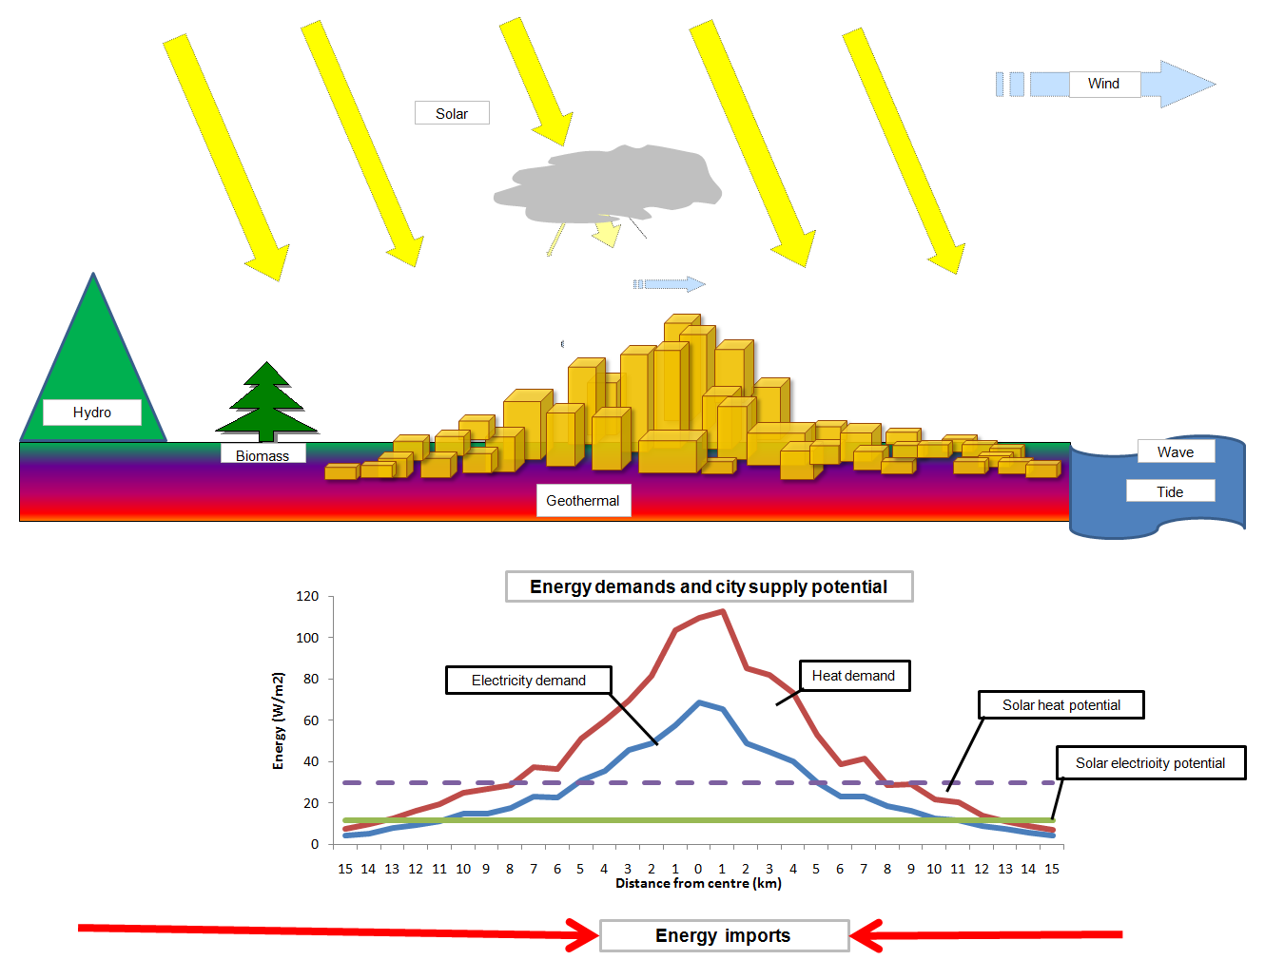
Leviathan – city level

Slide 11
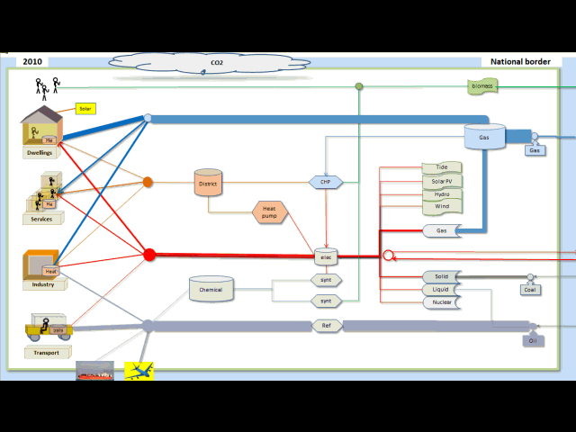
Leviathan’s evolution and physiology - the national energy system
Notes:
Energy demand, conversion and storage. Control system

Slide 12
How might Leviathan evolve
year by year to
securely use renewable energy
and reduce environmental risk?

Slide 13
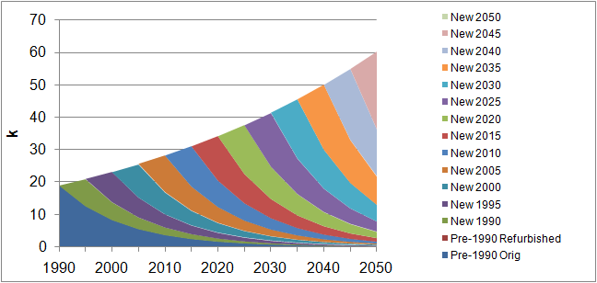
Lifetimes and rates of stock change
People ~80 years Dwellings ~ 100 years
Aircraft, ships, power stations ~ 35 years Cars, appliances ~15 years

Slide 14
Demography model (UK)
Age distribution by sex, 2008
Probability of dying in year
Population change: birth, death, migration probabilities
Population change: birth, death, migration changes

Slide 15
Fundamental drivers: demography, households and dwellings (UK)
Population uncertainty
Population: ageing
More energy per person in small households
Dwelling stock
Households: smaller
Notes:
The demography model also projects households number and households are mapped onto dwellings types. This is important because the carbon per person is much higher in small households.

Slide 16
Person-Dwelling Combinations (PDCs) - scenarios
Numbers of PDCs changing with:
Demolition
Existing (E)
Refurbishment (R)
New build (N)
Space and water heat load of PDCs changing with energy efficiency

Slide 17
Domestic scenarios
Monthly
Gradual change in fuel mix from mainly gas to electricity

Slide 18
Will Leviathan function
minute by minute?
society + engineering
Dynamic Energy Model
DynEMo

Slide 19
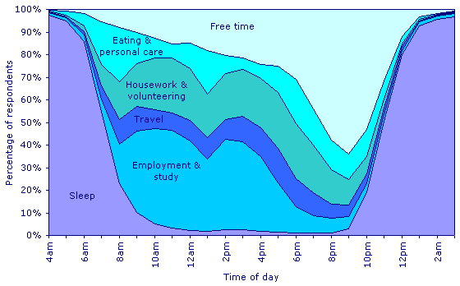
Activity by time over year
Human activity UK
Activity by time of day
Activity by space over year

Slide 20
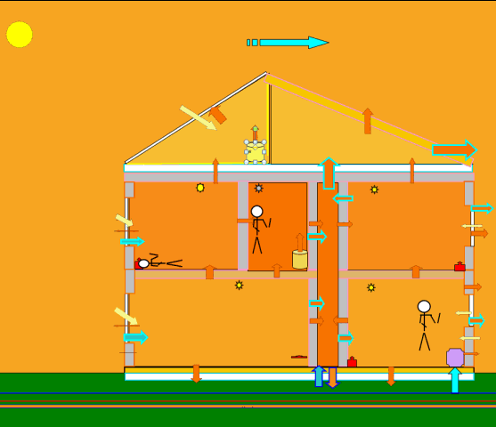
  Weather and Renewables
DynEMo Temporal drivers
Human use of time – UK
Quite invariable –
a diurnal mammal!

Slide 21
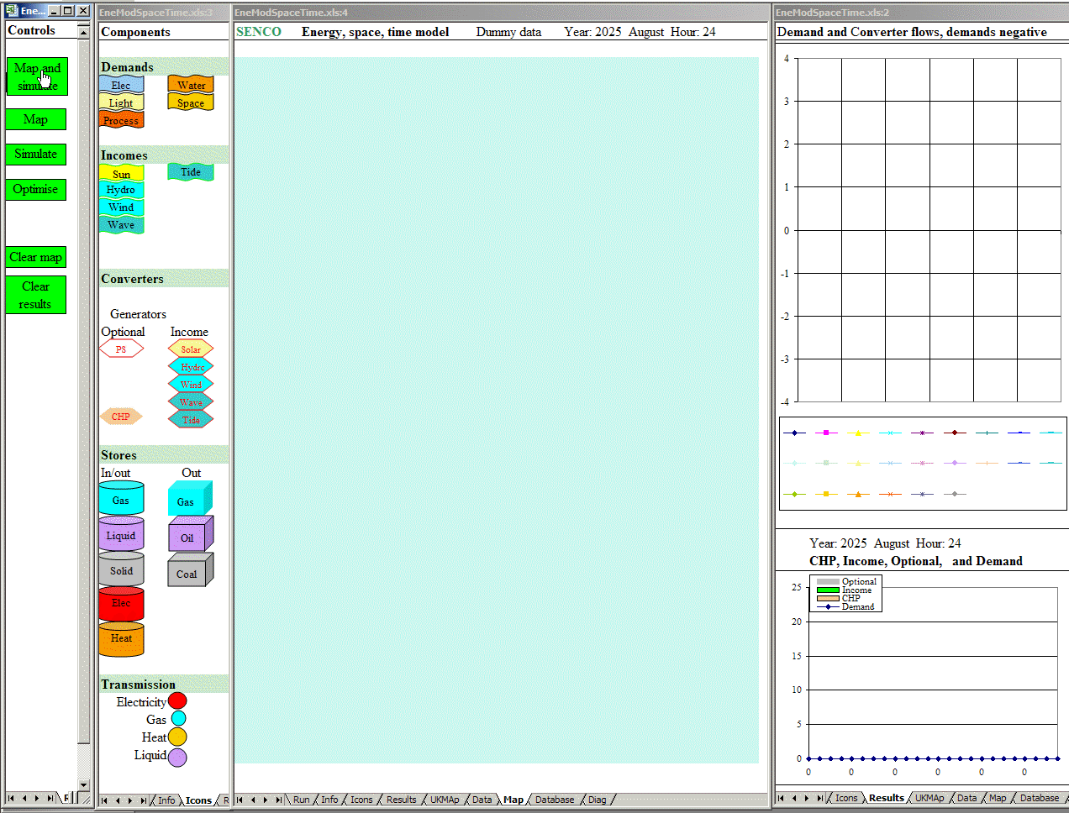
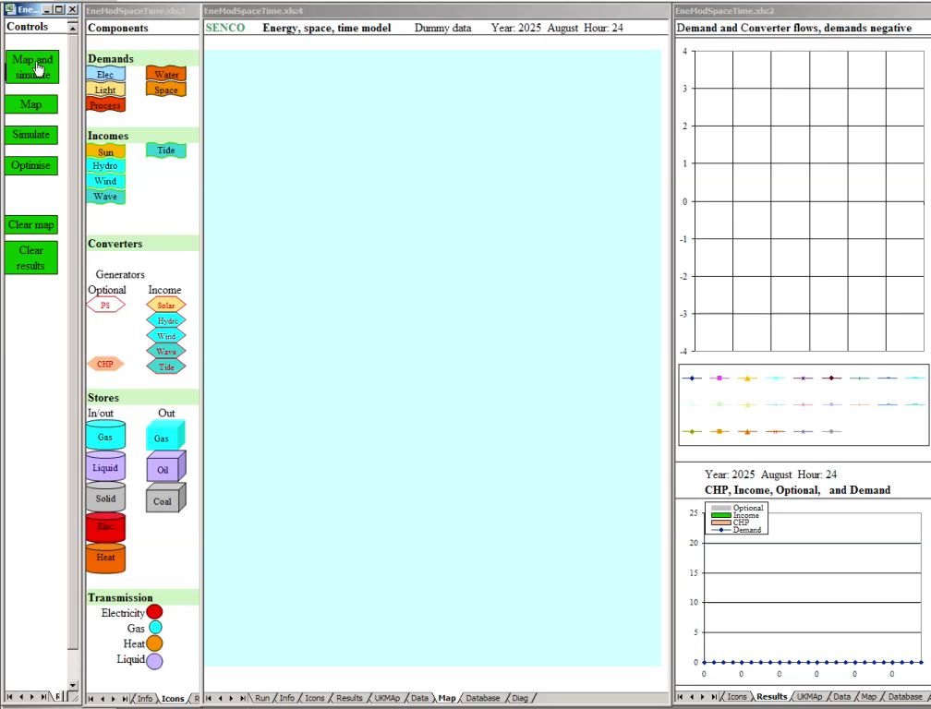
UK energy, space and time

Slide 22
Buildings: two sample archetypes
Heat pump single source peaks little storage
District heat diversity multiple inputs cheap storage implementation
Services:
heat, cool, light, cleaning, TV etc.
Notes:
DynEMo models a range of dwellings and occupancy types. Two commonly proposed archetypes are shown in here.

Slide 23
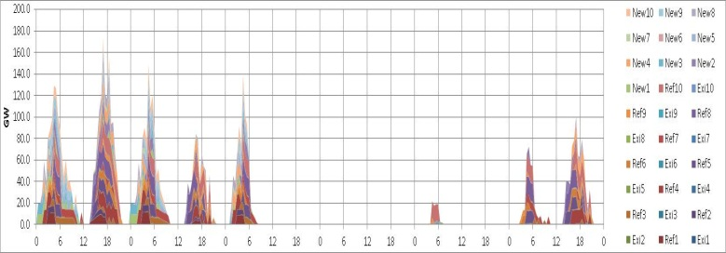
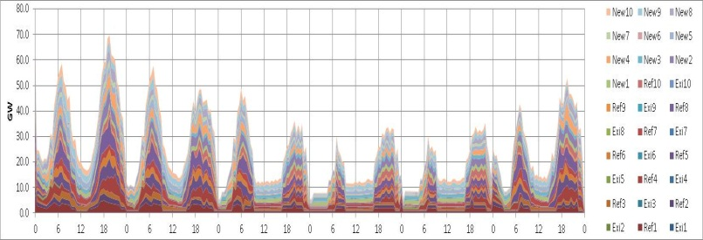
People dwelling calculation process
Weather
People and services
Dwelling
Useful energy
Delivered energy
Energy systems

Slide 24
Building dynamics : heating
Winter’s day
Months 1,4,7

Slide 25
Solar water heater
Winter’s day
Months 1,4,7

Slide 26
Heat pump and storage dynamics
Winter’s day modelled at 2min intervals
COP varies with ambient and heat store temperatures

Slide 27
DynEMo : Change the timing of flows with storage
How do we best control stores and other system components?
Electrically connected stores

Slide 28
Energy consumption – DynEMo one day for month 1 ; modelled at 5 min intervals
Domestic
District heat
Industry
Electricity consumed
Services
Transport
Fuel synthesis

Slide 29
Matching demand to supply – DynEMo 1 day for months 1 ; modelled at 5 min intervals
Useful energy
Storage
Electricity consumed
Electricity generation and trade

Slide 30

Dynamic system control - days : animation

Slide 31
Dynamic system control – months : animated

Slide 32

Electricity : system management optimisation animated

Slide 33

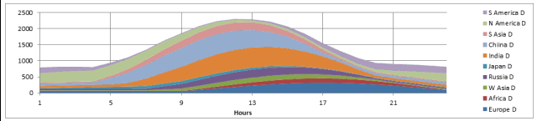
Energy, Space and Time
Solar variation is driven by the rotation of earth and annual orbiting.
Diurnal mammals activity and energy consumption correlate with solar energy.

Slide 34

Energy, Space and Time
– renewable electricity trade
Trade is a two way exchange with imports and exports at different times

Slide 35
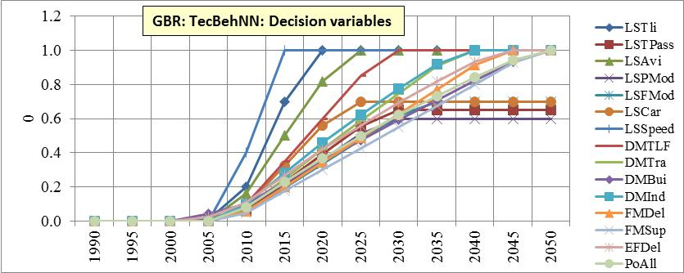
SEEScen : scenarios built on decision variables / policies

Slide 36
SEEScen examples: Transport and behaviour
Within 15 years, choosing small cars would reduce car energy and carbon by ~50% and UK total emissions by ~7%.
Within 5 yrs, enforcing speed limits would reduce motorway energy and emissions by ~15% and UK total by ~1.5%.
Modal shift from oil to renewable electricity supplying vehicles and railways an important option.
Aviation global warming cannot be levelled without reducing demand growth by about 50%.

Slide 37
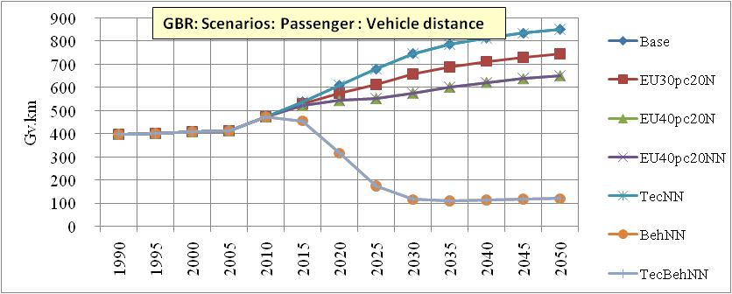
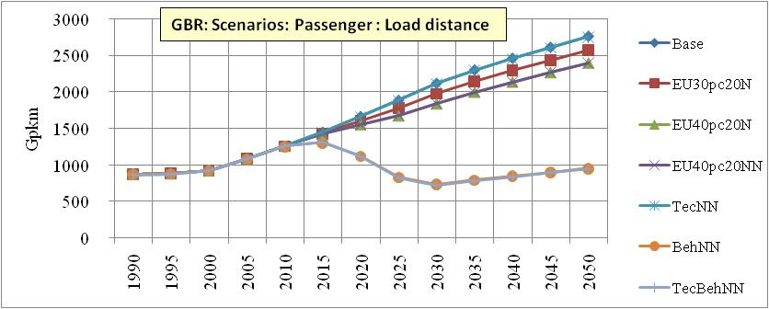
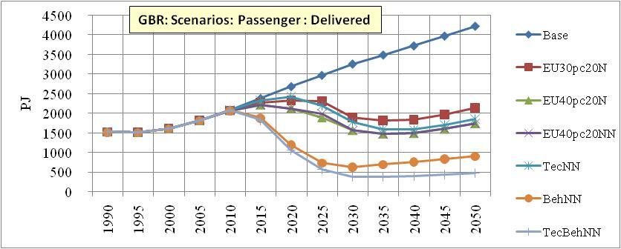
SEEScen : Transport: passenger: scenarios
.

Slide 38
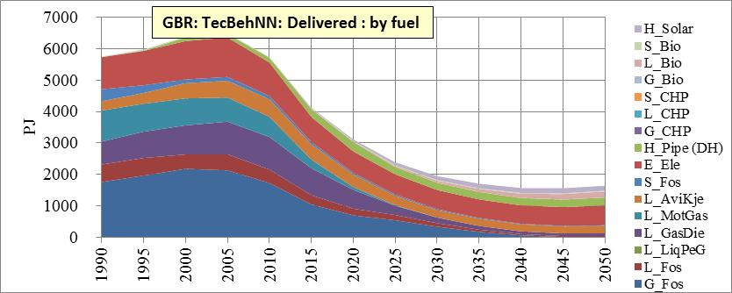
SEEScen sample: UK delivered energy
Move from gas and oil to electricity and heat

Slide 39
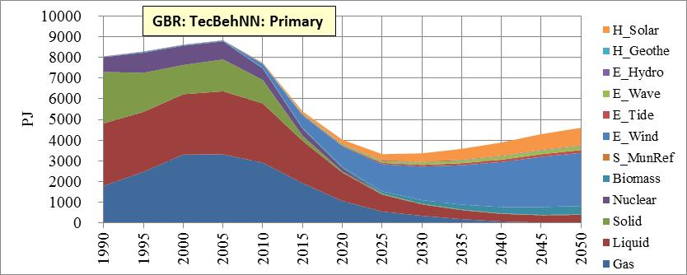
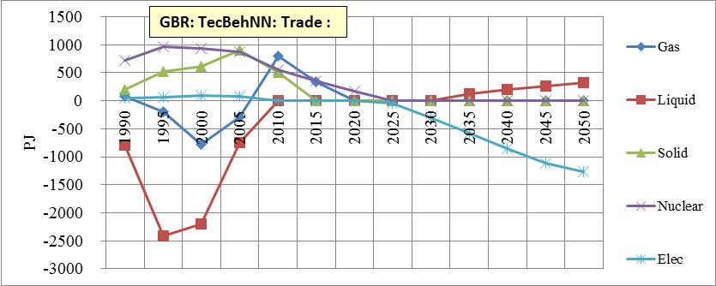
SEEScen sample: UK primary and trade

Slide 40
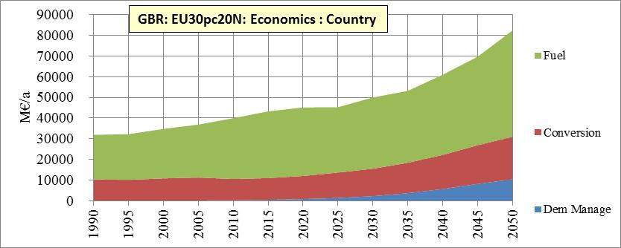
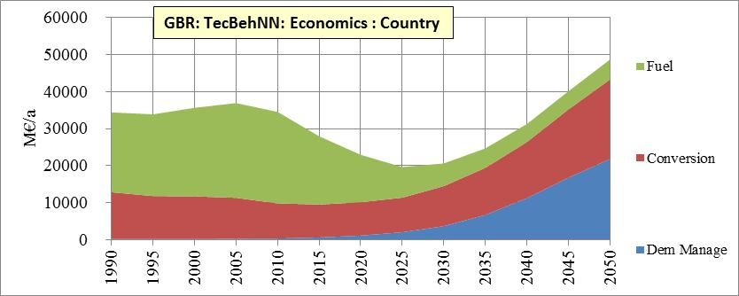
SEEScen sample economics : UK
High carbon:
High unpredictable fuel cost and prices
Low capital
Less predictable service cost
Low carbon:
Low fuel cost and prices
High capital
More predictable service cost

Slide 41
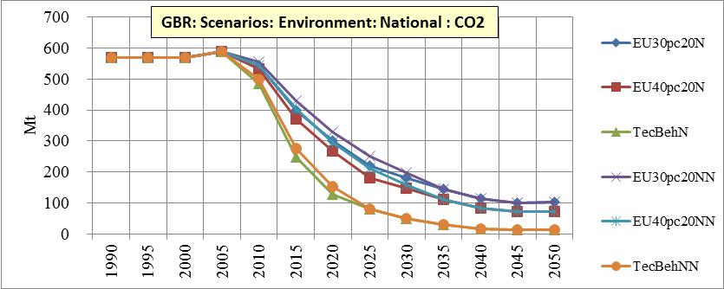
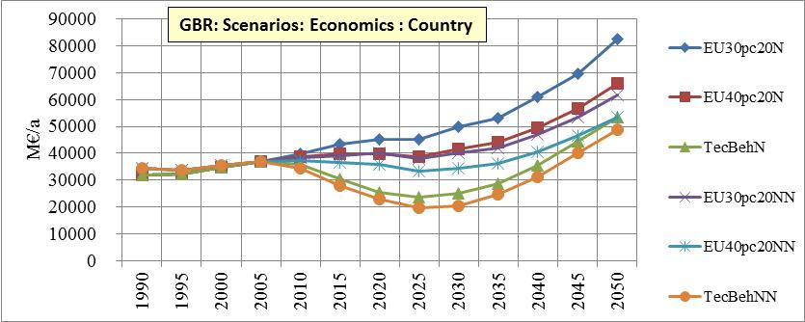
SEEScen sample: UK carbon and money
Will a low carbon energy
system cost
more or less than high carbon?
Depends on fossil fuel prices.
What will future fossil fuel prices be?
Nobody knows,
but the more carbon
the higher the fuel prices.

Slide 42
Aviation global warming – hard to control even with behaviour change
  Tropospheric emissions of NOx and water double or triple the CO2 induced global warming
  International aviation and shipping should be included in GHG inventories
  Maybe 50% of UK global warming will be caused by aviation in 2050

Slide 43
SEEScen : Europe low emission scenarios - demand drivers, 2005 projections
More households
Population peaks and declines
GDP growth
(ha ha!)

Slide 44
SEEScen : Europe low emission scenarios - CO2
Global warming is caused by total integrated emissions and time in the atmosphere.
Behavioural measures reduce emissions rapidly.
40% reduction, mix of measures, New nuclear
Maximum behaviour, No new nuclear
Maximum technology, No new nuclear
Maximum technology & behaviour, No new nuclear

Slide 45
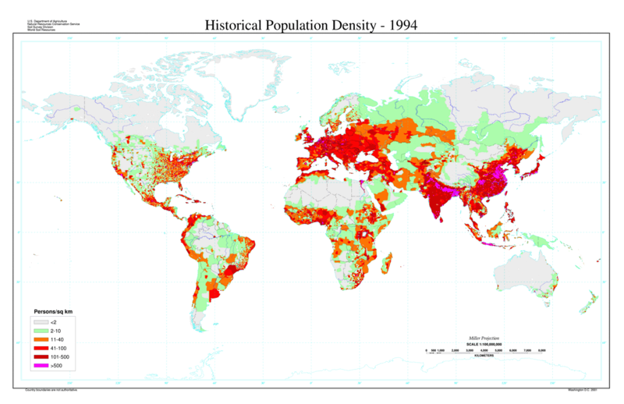
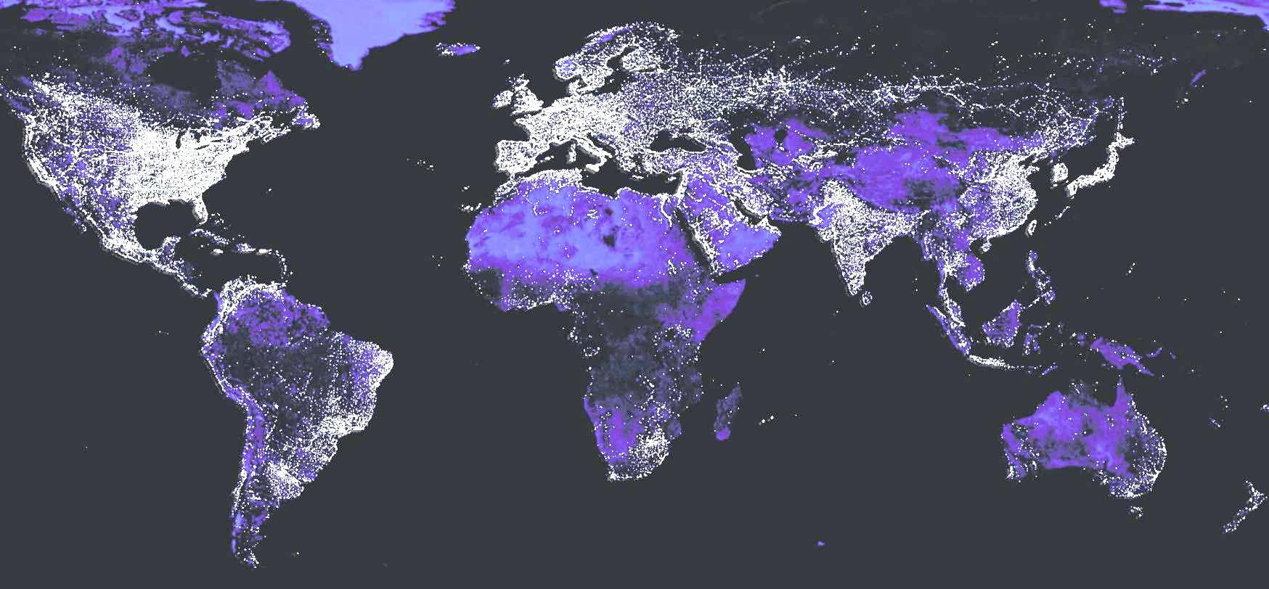
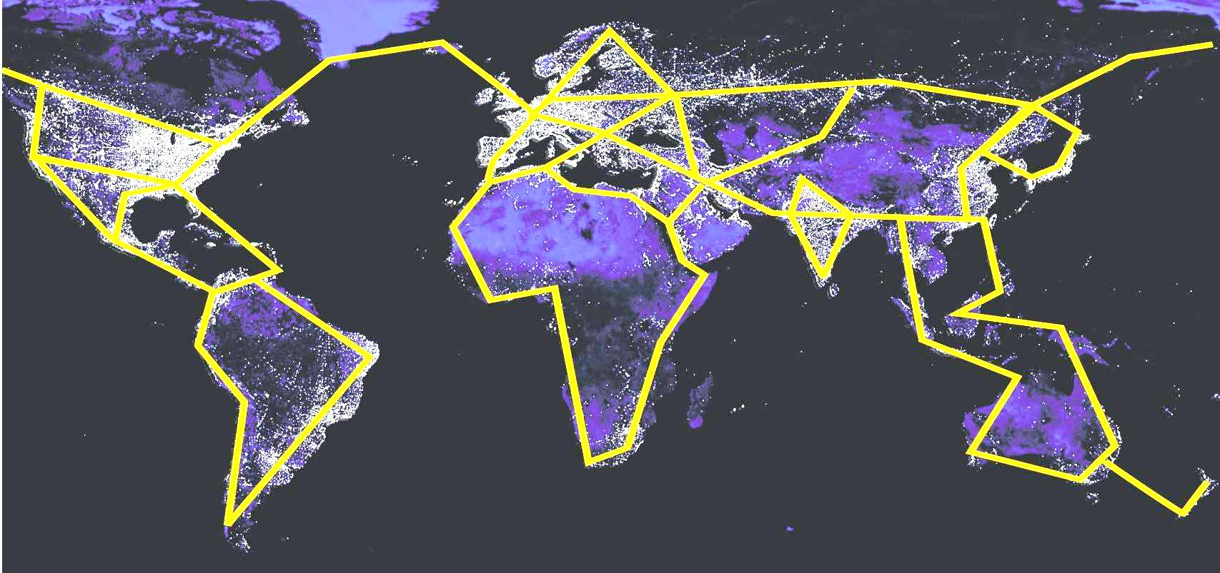

Leviathan’s global electric future?
Regular east-west diurnal, and seasonal, variations in demands and renewables
Match varying demand and supply with transmission as well as storage
Energy exchange enhances political security

Slide 46
CONCLUSIONS
The 300 year fossil blip in human history is coming to an end.
We do not yet have the technologies to sustain energy intensive lifestyles
To maintain energy security we are forced to use renewables
Rapid development is required to meet pressing energy security, economic stability and environmental problems.
Most required technologies already exist but boundless energy consumption cannot be met with them
Politicians and regulators need to provide the framework to facilitate development

Slide 47
Thank you for listening. Questions?
Email: Mark.Barrett@ucl.ac.uk
Site : www.SocietyEnergyEnvironment.net

