Slide 1
Integrating buildings into the national energy system
Mark Barrett
UCL Energy Institute, London
The Mediterranean Green Energy Forum 2013, Fez, Morocco, June 2013
Run presentation with F5 to see animations
Notes:
Simulates the system on any time steps. Demand for heat, light, appliances, power. It looks at the supply of the energy tech on the same time step and traces the flow of energies from primary to demand through the network of energy transformation and store. It calculates carbon emiss. And cost. It can be run for any period between 10 and 50 years and produce scenarios.

Slide 2
Contents
Objectives
Demands
  People
  Buildings
Supplies
  Building energy systems
  Public energy systems
Demand – supply integration
Notes on heat supply development

Slide 3
Some objectives
SOCIAL
Affordable energy services (alleviation of fuel poverty)
ENERGY SECURITY
Reduce dependence on finite fossil and nuclear fuels
Renewables: UK 15% of energy from renewables by 2020 => ~35% renewable electricity?
Renewable transport fuels: 5% of by 2010, 10% by 2020
ENVIRONMENT
Government targets for GHG reduction from 1990: 12-20% by 2010, ~30% by 2020, 80% 1990-2050, including international transport
Air pollution etc..

Slide 4
Overview
About
70% of national energy is consumed in buildings, including industry
50% of national energy is providing services for people in buildings;
  Space heating
  Air conditioning
  Water heating
  Lighting
  Appliances
  ICT

Slide 5
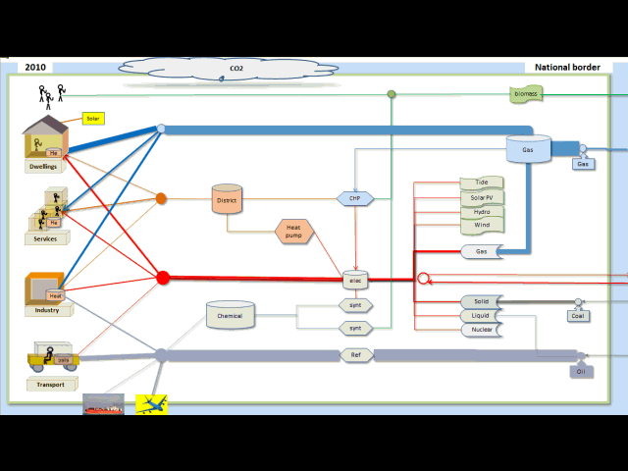
The national energy system
Notes:
Energy demand, conversion and storage. Control system

Slide 6
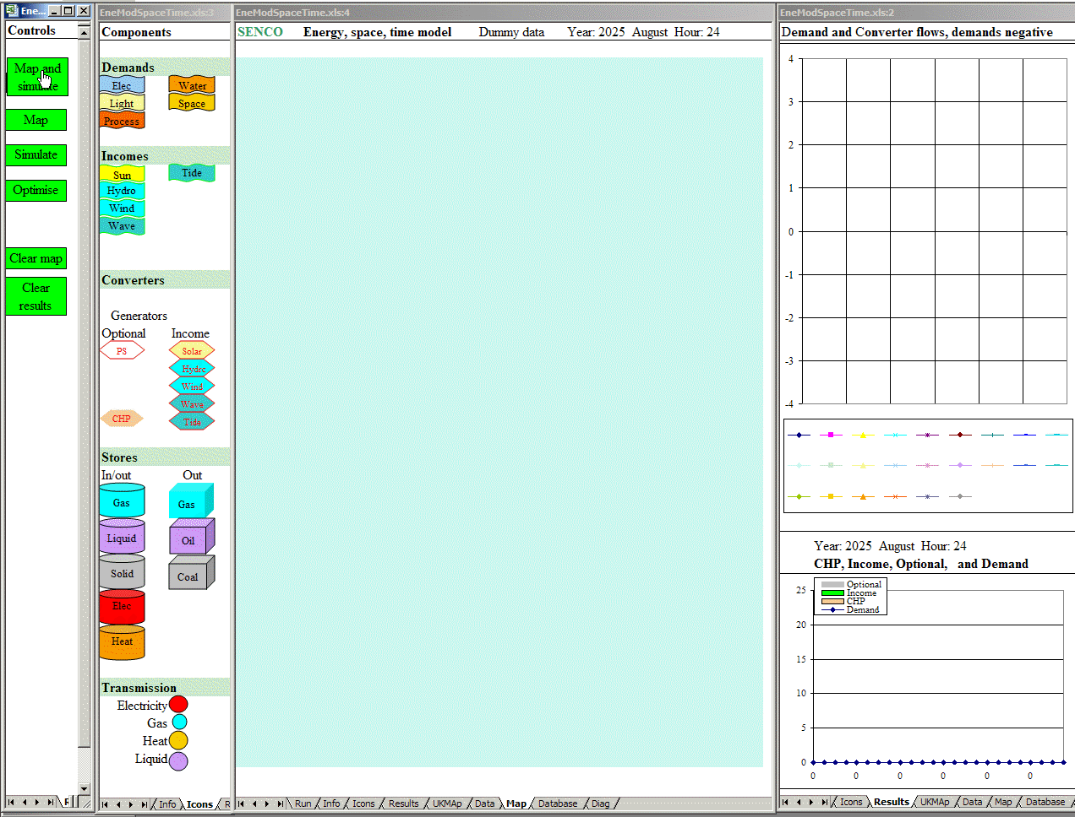
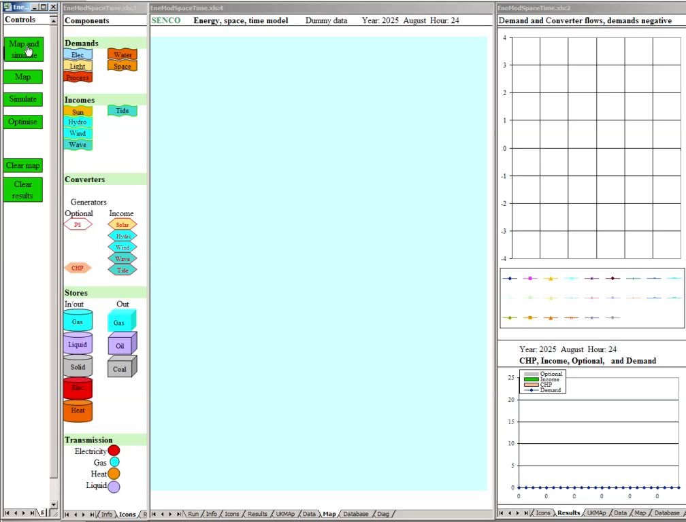
UK energy, space and time

Slide 7
Fundamental drivers: demography, households and dwellings (UK)
Population uncertainty
Population: ageing
More energy per person in small households
Dwelling stock
Households: smaller
Notes:
The demography model also projects households number and households are mapped onto dwellings types. This is important because the carbon per person is much higher in small households.

Slide 8
PEOPLE-DWELLNG COMBINATIONS (SEGMENTS) and SCENARIO INPUTS
Values needed for base year (e.g. 2010) and projection assumptions
How many PDCs / segments to accurately model?
People:
Population, households, dwellings
Occupancy and internal temperatures
Dwellings:
Demolition, refurbishment, new build
Efficiency, heat losses, appliances
Energy systems – main heater, solar hot water
System controls

Slide 9
Person-Dwelling Combinations (PDCs) - scenarios
Numbers of PDCs changing with:
Demolition
Existing (E)
Refurbishment (R)
New build (N)
Space and water heat load of PDCs changing with energy efficiency

Slide 10
Domestic scenarios
Monthly
Gradual change in fuel mix from mainly gas to electricity

Slide 11
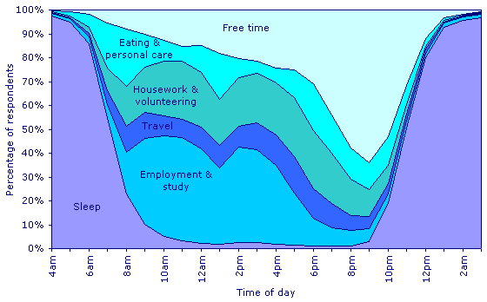
Activity by time over year
Human activity UK
Activity by time of day
Activity by space over year

Slide 12

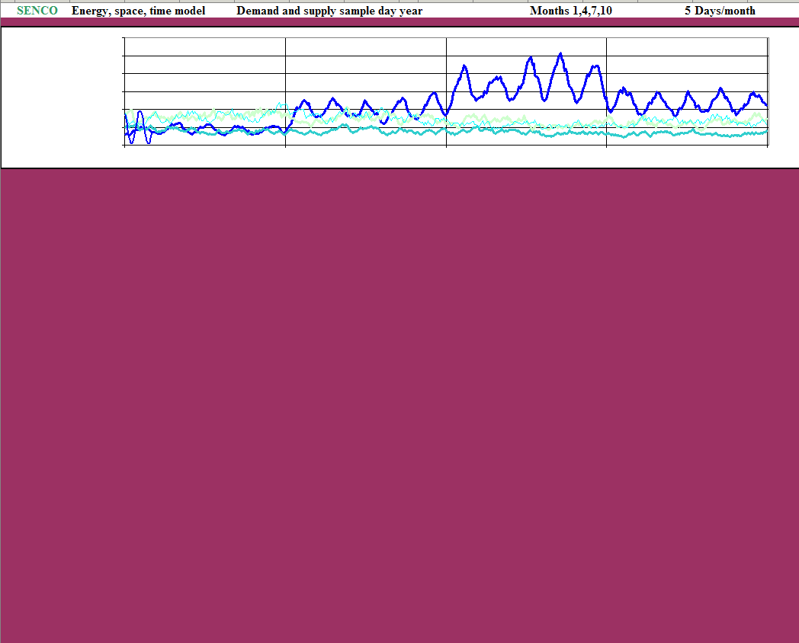
  Weather and Renewables
DynEMo Temporal drivers
Human use of time – UK
Quite invariable –
a diurnal mammal!

Slide 13
Buildings: two sample archetypes
Heat pump single source peaks little storage
District heat diversity multiple inputs cheap storage implementation
Services:
heat, cool, light, cleaning, TV etc.
Notes:
DynEMo models a range of dwellings and occupancy types. Two commonly proposed archetypes are shown in here.

Slide 14
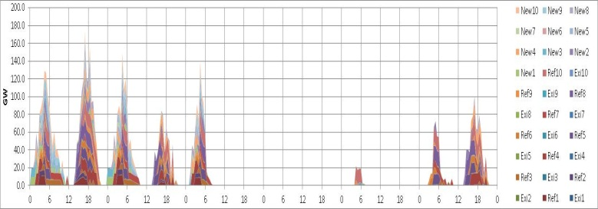
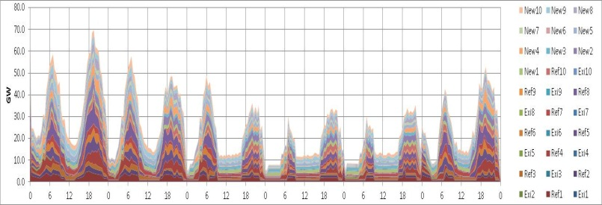
People dwelling calculation process
Weather
People and services
Dwelling
Useful energy
Delivered energy
Energy systems

Slide 15
Building dynamics : heating
Winter’s day
Months 1,4,7

Slide 16
Solar water heater
Winter’s day
Months 1,4,7

Slide 17
TECHNOLOGIES – heat pumps
The performance of heat pumps depends on:
Input temperature
Output temperature
Heat/cool load
Technology – design and size
Assumed that COP is some fraction of ideal Carnot that increases with scale
district heat > industrial >services > domestic
The COP curves below are assumed for 2050 (10% better than current).
Note that output temperature will vary, especially with heat storage.

Slide 18
Heat pump and storage dynamics
Winter’s day modelled at 2min intervals
COP varies with ambient and heat store temperatures

Slide 19
Load curves for Person-Dwelling Combinations
Appliances
Light
Notes:
Load curves for these months for each PDC

Slide 20
Load curves for Person-Dwelling Combinations
Passive solar gain
Solar water heating
Notes:
Load curves for these months for each PDC

Slide 21
Load curves for Person-Dwelling Combinations
Water heat demand
Space heater emission
Notes:
Load curves for these months for each PDC

Slide 22
Load curves for Person-Dwelling Combinations
Auxiliary boiler/heat pump
Heat pump electricity emission
Notes:
Load curves for these months for each PDC

Slide 23
Load curves for Person-Dwelling Combinations
District heat delivered
Delivered electricity

Slide 24
Heat, electricity and system integration
Demands
Space and water demand vary with activity and weather (temperature, wind, solar)
Electric heat supply with heat pumps with weather varying COP
High renewable fractions will include a large wind component;
what will happen when there is a deficit or surplus of renewable energy of perhaps 100 GW?
Supplies:
Renewables vary with weather
Dispatchable renewables
Matching
Dispatchable supplies - chemical fossil/biomass, some hydro
Storage – heat, chemical, mechanical
Transmisson
A large fraction of electricity will be used for heat.
Electricity is expensive to store, heat is cheap to store

Slide 25
Variation of building heat losses with weather
Building specific heat loss (ventilation and fabric) increases with wind speed and temperature difference (DT) because of ventilation (stack and wind driven) and surface loss effects.
Such effects cause positive and negative correlations between demands and renewable supplies and impact on the matching problem.
E.g., demand and wind generation both increase with wind speed and so will be positively correlated in general.
Modelled variation of UK dwellings heat load with wind speed for different internal-ambient temperature differences (DT)

Slide 26
District heating
Heat inputs
CHP – biomass, gas
Electric heat pumps when surplus renewable electricity
Notes:
Liquid synthetic fuel production (hydrocarbon, ammonia)
District heat/CHP
Storage

Slide 27
TECHNOLOGIES – district heating and CHP
Currently, district heating pipe and CHP efficiencies are assumed constant as shown below.
In reality, efficiencies will vary with conditions – particularly temperatures.
It assumed that all heat input to district heating is from CHP or heat pumps.
In reality, other heat sources including heat only boilers might be used.

Slide 28
District heating
Notes:
Liquid synthetic fuel production (hydrocarbon, ammonia)
District heat/CHP
Storage

Slide 29
National system – storage

Slide 30
Energy consumption – DynEMo one day for month 1 ; modelled at 5 min intervals
Domestic
District heat
Industry
Electricity consumed
Services
Transport
Fuel synthesis

Slide 31

Electricity : system management optimisation animated

Slide 32

Dynamic system control - days : animation

Slide 33
Dynamic system control – months : animated

Slide 34
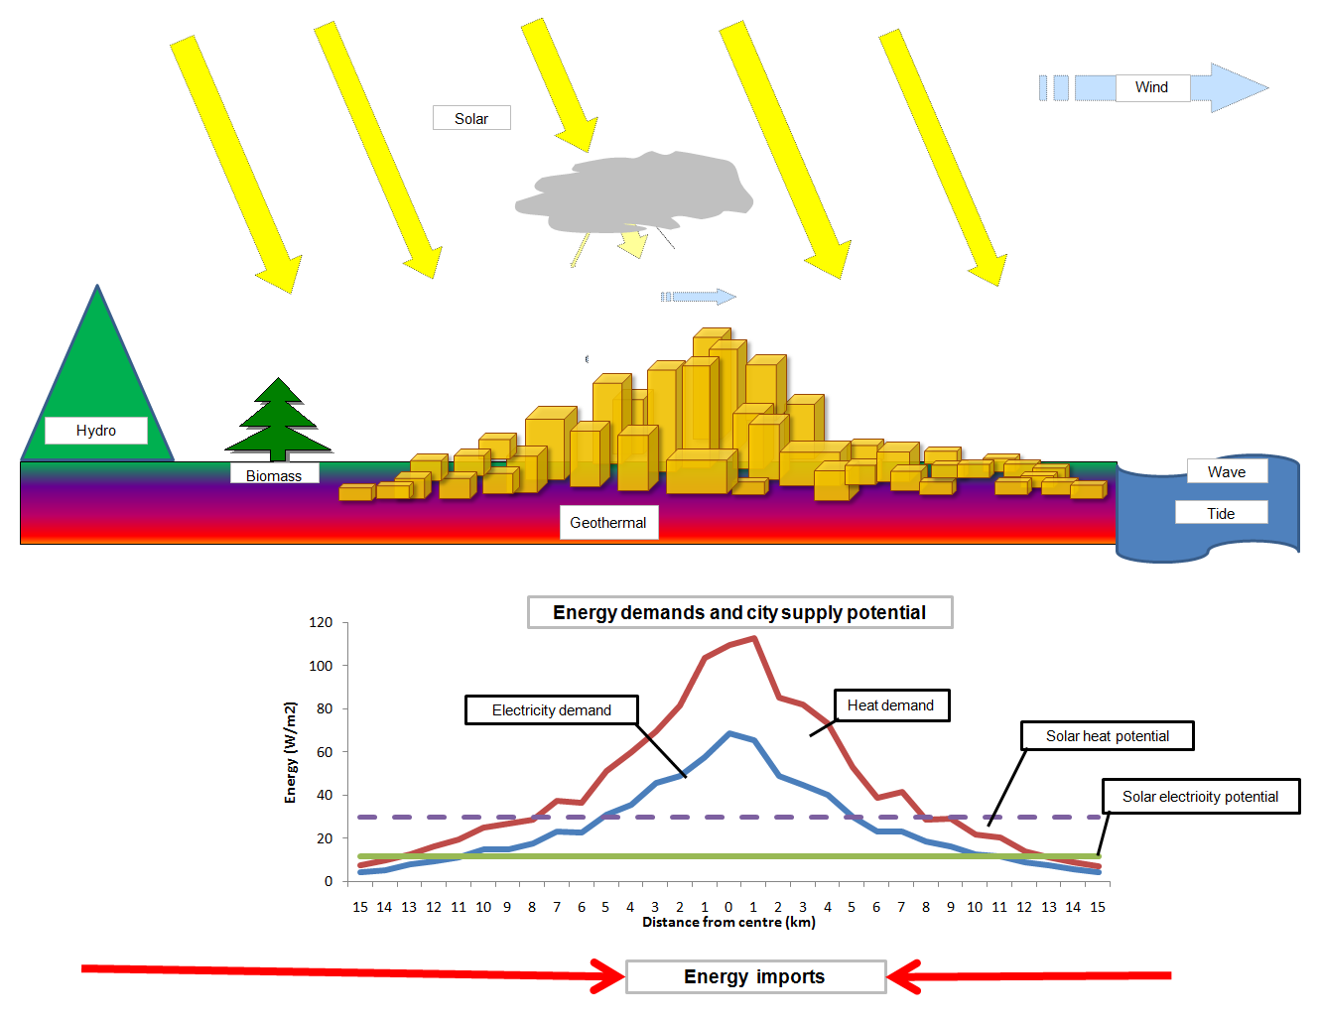
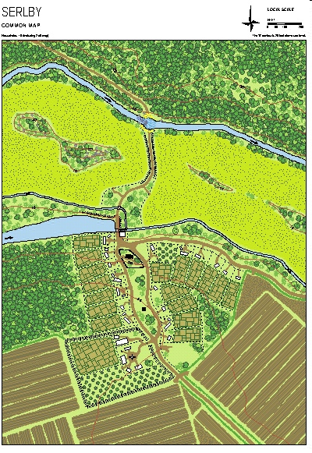
Energy, Space and Time : Leviathan’s organs sizes
Cities as energy importers
Increasing size
=>
increasing transmission
Radius of self sufficiency increases from
~ 50 km
A village is a
solar collector
3 billion people urbanising
to ~20,000 km
(the world!)

Slide 35

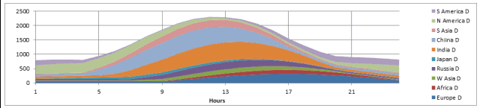
Energy, Space and Time
Solar variation is driven by the rotation of earth and annual orbiting.
Diurnal mammals activity and energy consumption correlate with solar energy.

Slide 36

Energy, Space and Time
– renewable electricity trade
Trade is a two way exchange with imports and exports at different times

Slide 37
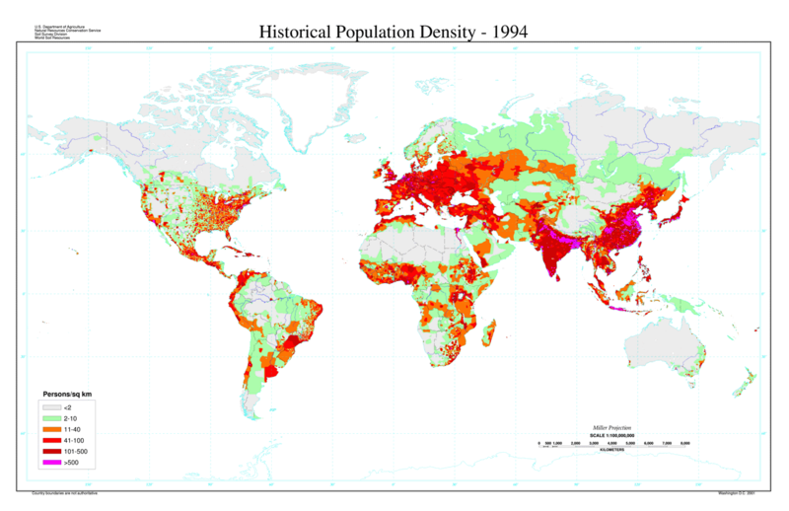
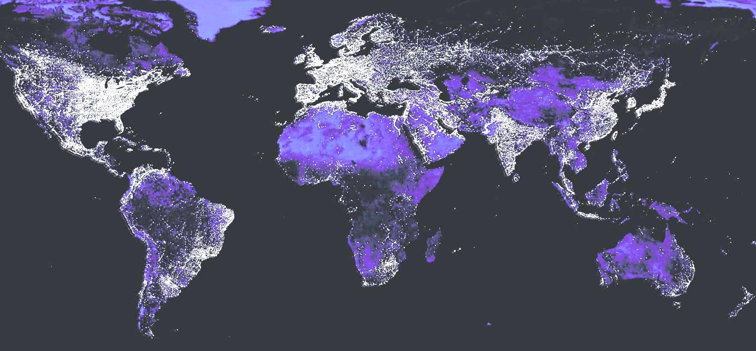
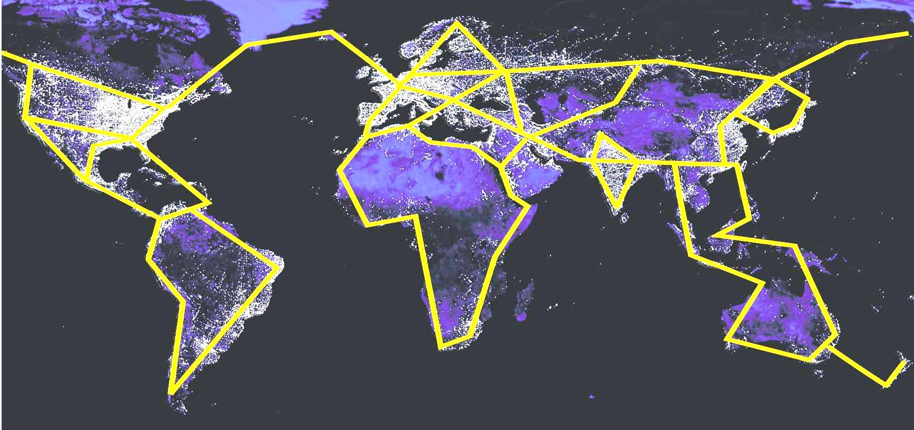
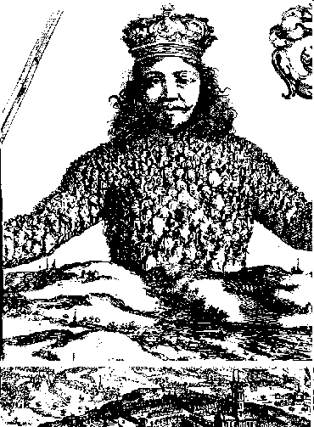
Leviathan’s global electric future?
Regular east-west diurnal, and seasonal, variations in demands and renewables
Match varying demand and supply with transmission as well as storage
Energy exchange enhances political security

Slide 38
Demand – services

Slide 39
Heat development –issues
Heat demands :
Quantity, temperature, time, space
Heat loads:
Buildings – HW, space
Industry – process, space heat
Fuel synthesis – HT heat
Heat supply:
Collectors: solar, geothermal
Converters: boilers. electric heat pumps
Vectors: gas, electricity, district heating
Primary supply
Gas, oil, coal, nuclear
Renewable electricity
Biomass
How to design a least cost system with the above so as to meet objectives?
Interactions with other demands and vectors.

Slide 40
Heat supply development - transition
What will happen to the gas grid?
Will the whole gas system be retained, or just part?
Will it be used for:
High volume supply with renewable gas and/or CCS
Backup to biomass CHP, heat pumps etc?
Develop DH networks from:
Nuclei of large heat loads (office blocks, hospitals etc.) initially with gas CHP input
Existing urban power stations? Initially fossil, then biomass?
Suitable heat source for heat pumps - e.g. sea, river (e.g. Stockholm)
Individual electric heat pumps
Installed in addition to current boilers to reduce electric peak load?
What heat emitters – air/radiator? Alongside MHVR?
What storage?
Fuel production and waste heat or heat demand
Refining: coastal near ports. Currently ~10 GW CHP equivalent
Fuel synthesis plants: electricity to ammonia, hydrocarbons, hydrogen, biofuels
  Sited near coasts/ports to absorb off-shore wind/biomass and for sea transport or use (ammonia)
  Sited at filling stations?

Slide 41
Heat and DH
National context for DH
Heat demand
domestic, industry, services, refineries etc.:
  quantities, load density, temperatures, temporal pattern
B. Fundamental technical and economic analysis
What fraction of heat demand to be met by DH? What densities of heat loads and total size?
What heat inputs to DH: technologies - boiler/CHP/heat pumps/solar; fuels - biomass, gas.?What configurations? How much heat storage?
How will DH fit into the national energy system and meet constraints like carbon and biomass availability?
How will DH system operate dynamically in high renewable energy systems?
C. Policy specific to DH
Implementation: Building regulations/ standards, local planning, utility requirements.
Public infrastructure investment
Heat, gas and electricity market structures: contracts, pricing etc.
Foreign experience

Slide 42
District heat – economics and developing the market
Central problem:
High capital cost and long development and operation times means DH suppliers need long contracts and high take-up of consumers.
In a locale, this restricts consumer choice in end use energy supply type (e.g. gas or DH), and frequency with which fuel switches can be made (e.g. maximum contract length increasing from months to 15 years); but it reduces fuel price fluctuations because of DH multi-fuelling and efficiency with CHP/HPs.
Economics of DH must be comparative;
What are capital costs compared to alternatives? E.g. the alternative of increasing the capacity of dispatchable generation and low voltage electricity distribution to accommodate individual heat pumps in dwellings.
What are the variable fuel and operating costs of alternatives? E.g. individual heat pumps or gas boilers now and in the future?
What are the economic benefits of DH in terms of:
  multi-fuelling (CHP+HPs+…) that may be adjusted instantly or in long term with no consumer impact?
  lower carbon emissions?
  Role in the energy system with dynamic fuel mix changing and storage, so as to integrate, for example, a large wind component?
To overcome problem
What financial incentives?
What changes to regulation of energy market, buildings, planning, etc. are required?

Slide 43
District heat development – some possible drivers / facilitators
Building regulations: ‘zero carbon’, energy supply
Planning regulations: e.g. Merton type rule
Energy supply drivers.
  E.g. offshore wind->HP+DH, renewable target to absorb wind (inc. CHP, HPs?)
  RHI etc
Energy system coherence. Role of DH as system balancer.
Carbon target, ETS.
Power stations; old and new. CHP mandate. IPPC. LCPD.
Market structure and regulation.

Slide 44
District heat : transfer of foreign success
60% of Danish houses have DH
Stockholm has DH with inputs from CHP, waste heat, large heat pumps using sea heat
Gothenburg DH:
offers consumers the choice between DH and ground source HPs
extends its DH system to very low density housing on rocky terrain
has inputs from waste incineration, fossil plant etc.
How do they do it, knowledge transfer
Organise seminars to bring successful practitioners to the UK. Advice on technical, economic, regulatory, local political, social aspects of DH. Attendees: foreign experts and UK DECC, LAs, industry, investors, consultants etc.
Aim for lead demonstration UK DH systems small/medium scale with Scandinavian aid. New schemes and/or extensions of existing (from nuclei) e.g. Southampton, Woking, Pimlico. Build on existing initiatives. Consider dominant building/industrial loads, proximity to heat sources such as existing power stations.
.

Slide 45
Thank you for listening. Questions?
Email: Mark.Barrett@ucl.ac.uk
Site : www.SocietyEnergyEnvironment.net

