Slide 1
Dynamic Energy Model
Energy scenarios and system dynamics
Mark Barrett, Catalina Spataru
UCL Energy Institute, London
Common Road to 2050 : Energy networks and policy (ENP 2050)
3 July 2013
Notes:
Simulates the system on any time steps. Demand for heat, light, appliances, power. It looks at the supply of the energy tech on the same time step and traces the flow of energies from primary to demand through the network of energy transformation and store. It calculates carbon emiss. And cost. It can be run for any period between 10 and 50 years and produce scenarios.

Slide 2
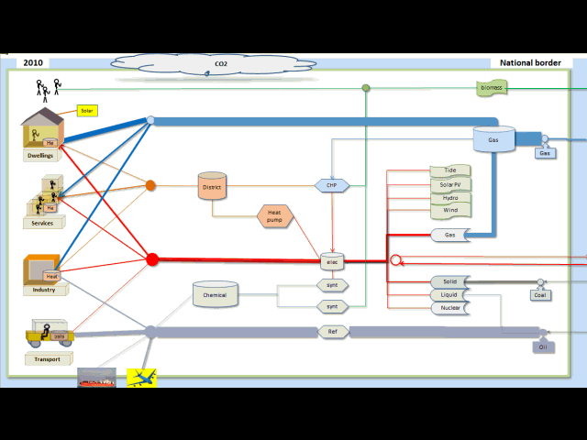
The national energy system – dynamic, non-linear
Notes:
Energy demand, conversion and storage. Control system

Slide 3
SCENARIO
OBJECTIVES
Society, Energy, Environment
Least cost services whilst meeting objectives
SCENARIO FEATURES
Energy efficiency
High renewables: wind, solar, biomass
Storage, multi-fuelling
International connection
WILL THE SYSTEM WORK?

Slide 4
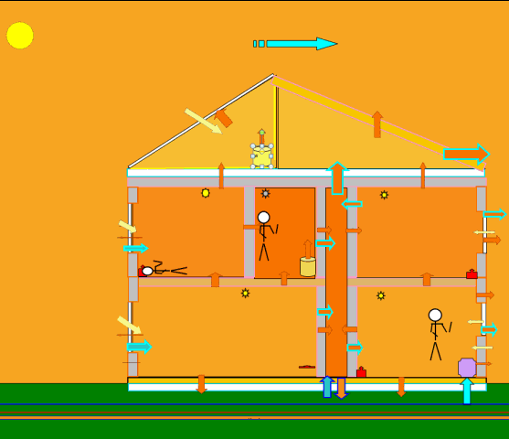
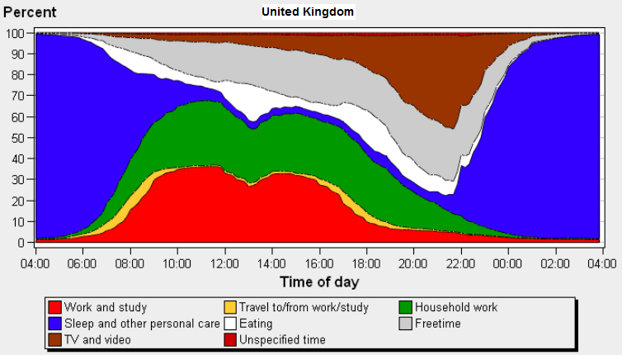
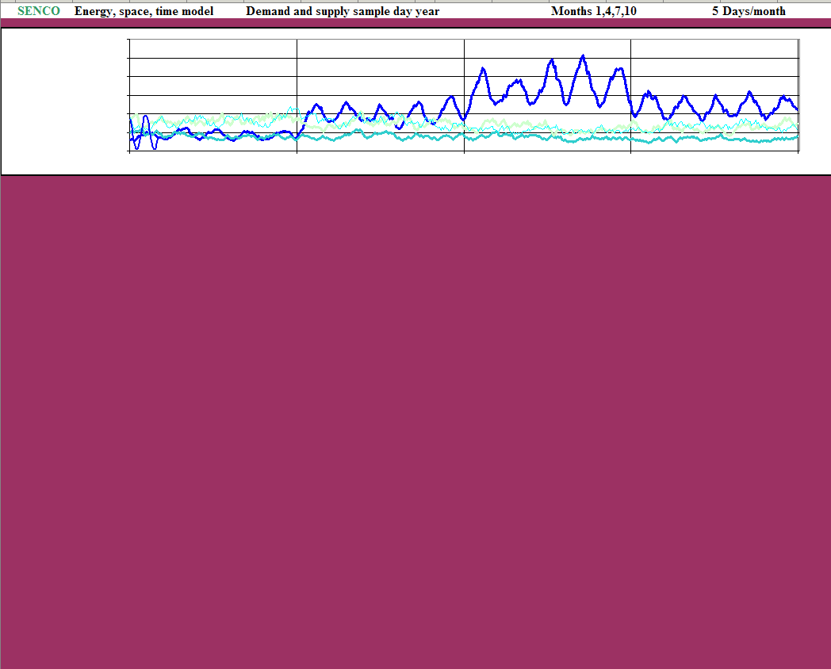
  Weather and Renewables
DynEMo Temporal drivers
Human use of time (UK)
Quite invariable –
a diurnal mammal!

Slide 5
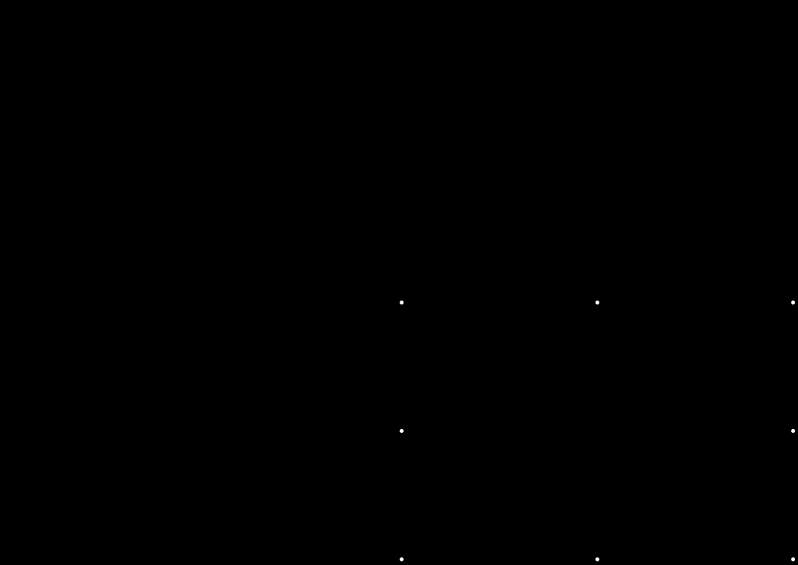
Dynamic system control - days : animation

Slide 6
Dynamic system control – months : animated

Slide 7
SYSTEM CONTROL
Whole system control across all components to give secure, least cost supplies and meet objectives such as carbon – including control of:
Building heating and cooling
Stores
Dispatchable supplies and generation
Multi-fuel switching – e.g. between heat pumps and CHP
International trade
Control should include forecast demand and supply.
Complex, non-linear system so biological, heuristic algorithms useful.
How to implement through regulation and market?
Experience shows centralised control practicable.
‘Decentralised’ control may not be stable, low cost or wanted by consumers!

Slide 8
National – electrically connected storage in scenario
What matters most technically?
kW in
kWh stored
kW out
Efficiency = Eout / Ein

Slide 9
Energy consumption – DynEMo one day for month 1 ; modelled at 5 min intervals
Domestic
District heat
Industry
Electricity consumed
Services
Transport
Fuel synthesis

Slide 10
Matching demand to supply
DynEMo 1 day for months 1,4,7 ; modelled at 5 min intervals
Storage levels
Electricity generation and trade
Useful energy
Storage modified demands
Uncontrollable renewables

Slide 11
System stress conditions: 2050 – one day for months 1, 7 ; modelled at 5 min intervals
Design of system for high demand and minimum renewable supply.
Winter: cold, no wind. Summer: hot, no wind

Slide 12
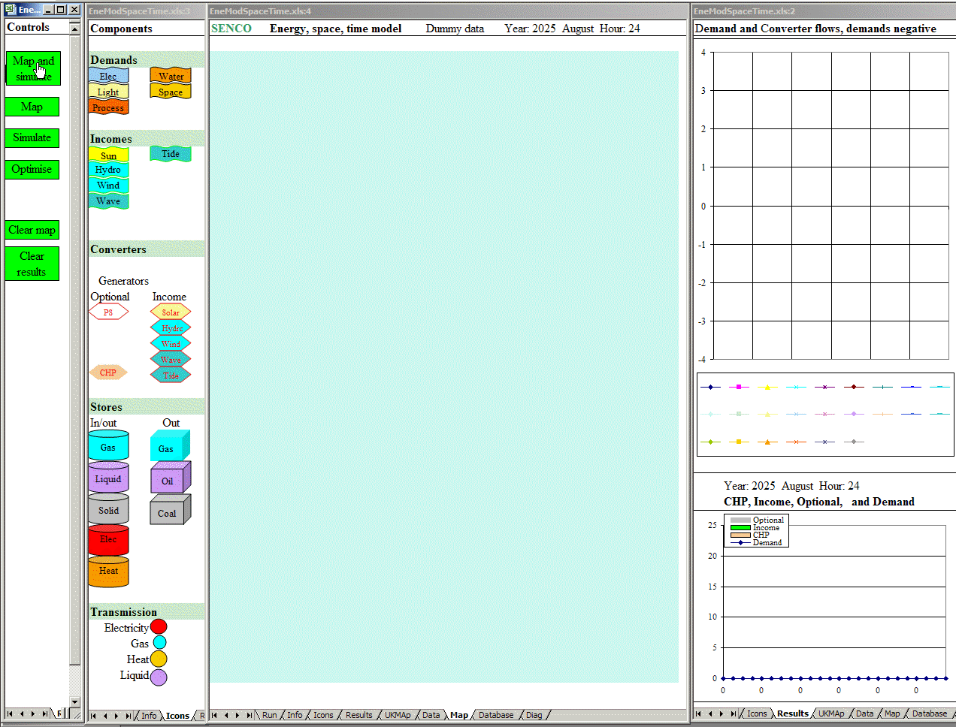
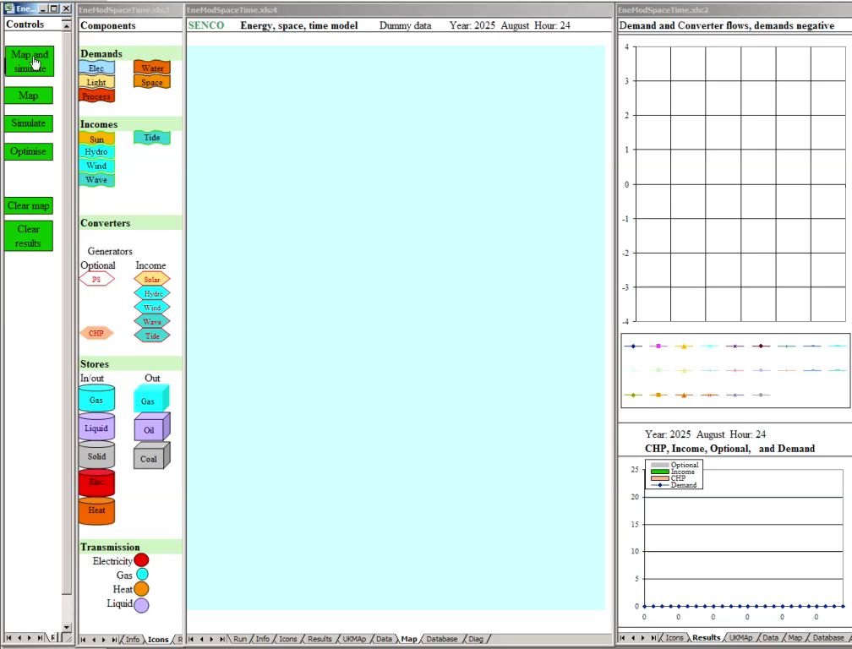
UK energy, space and time

Slide 13

Energy, Space and Time
– renewable electricity trade
Trade is a two way exchange with imports and exports at different times

Slide 14
Conclusions
Have to consider whole system dynamics from minutes to years, as driven by people, weather and technologies – national and international
Ensure security in stress conditions
Whole system control algorithms hard to devise for modelling – and how to implement in society?
Need to optimise configuration and control at the same time against given policy objectives
Whole system modelling essential for stakeholders to design future systems

Slide 15
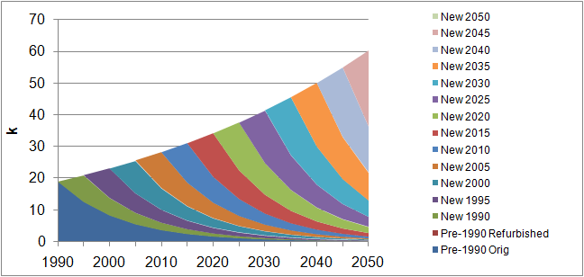
Rates of stock change over years
People ~80 years Dwellings ~ 100 years
Aircraft, ships, power stations ~ 35 years Cars, appliances ~15 years

Slide 16
National electricity supply
2050 – one day for months 1,4,7, 10 ; modelled at 10 min intervals
Smart grid algorithm applied to match demand and supply with storage.
Electricity:
Demand
CHP
Renewables
Dispatchable supply
Trade

Slide 17
STORAGE CONTROL ALGORITHMS
Example 1: Sequential surplus renewable electricity allocation to stores
The surplus to store control algorithm allocates any uncontrollable electricity surplus to flows with storage – heating, EVs, district heating, synthetic fuel production
The surplus is sequentially allocated according to proximity to service, energy store size and the availability of multi-fuelling:
  domestic (heat stores)
  electric vehicle (batteries)
  services (heat stores)
  industry (heat stores)
  district heating (heat stores)
  synthetic fuels (chemical stores)
  electricity system storage (e.g. pumped storage)
If all demands are met and stores or input capacities are full, any remaining surplus is exported or spilled

Slide 18
Optimising storage configuration for whole system
What types and sizes of stores connected where in the energy system?
How do we optimise?
1. Accurately simulate whole energy system dynamics over short time steps.
Quite difficult if transmission included as spatial dimension then needed
2. Optimise dynamic system.
Very difficult– system is non-linear over perhaps 500-5000 time steps.
Transmission interconnection can produce most of the same benefits – how much storage, how much transmission?
Should optimise whole system configuration and control at the same time

